Slide 1
TITANIC SURVIVAL PREDICTION
PROJECT REPORT

Slide 2
Project content
1. Introduction
2. Python libraries used
3. Data overview
4. Data cleaning
5. Data visualization(EDA)
6. Predictions
7. Conclusion

Slide 3
INTRODUCTION
The sinking of this "unsinkable" ship on April 15, 1912, claimed over 1,500 lives, leaving an indelible mark on the collective consciousness of humanity.
More than a century later, the Titanic continues to captivate our imaginations, serving not only as a cautionary tale of technological hubris but also as a compelling case study for data analysis and predictive modeling.
In this project, we delve into the realm of machine learning to predict who among the passengers aboard the Titanic was were most likely to survive this fateful voyage.
Utilizing a dataset comprising passenger information such as age, gender, class, and embarkation point, along with the known outcomes of survival, we aim to construct a predictive model capable of discerning patterns and factors that influenced survival rates.

Slide 4
PYTHON LIBRARIES
1. Pandas(pd):The pandas library is a powerful tool for data manipulation and analysis in Python. It provides data structures and functions to efficiently work with structured data, such as tables or spreadsheets. With pandas, you can easily load learn, transform, analyze, and visualize data.
2. Numpy(np): NumPy is a Python library used for working with arrays. It also has functions for working in the domain of linear algebra, Fourier transform, and matrices.
3. Seaborn(sns): Seaborn is a Python data visualization library based on matplotlib. It provides a high-level interface for drawing attractive and informative statistical graphics.
4.Matplotlib.pyplot(plt): Matplotlib is a comprehensive library for creating static, animated, and interactive visualizations in Python.
5. Warnings: The warnings module is used to handle warnings that occur during program execution. In this case, you've suppressed all warnings from being displayed with warnings. filterwarnings('ignore').

Slide 5
7. Sklearn. preprocessing.LabelEncoder: is a utility class in scikit-learn, a popular Python machine-learning library. Its primary function is to encode categorical labels as numerical values.
8. Sklearn.model_selection.train_test_split: This function is used to split datasets into random train and test subsets. It's commonly used for model evaluation and validation.
9. Sklearn. ensemble.RandomForestClassifier: RandomForestClassifier is an ensemble learning method used for classification tasks. It fits several decision tree classifiers on various sub-samples of the dataset and uses averaging to improve the predictive accuracy and control over-fitting.
10.Sklearn.metrics.accuracy_score: accuracy_score is a function used to compute the accuracy classification score, which is the fraction of correct predictions among the total number of predictions made.
11. Sklearn.metrics.classification_report: classification_report is a function used to build a text report showing the main classification metrics (precision, recall, F1-score, and support) for each class in a classification task.

Slide 6
DATA OVERVIEW
0-Not Survived
1-Survived
891-Rows
11- Columns

Slide 7

DATA CLEANING
Remove the 'PassengerId' column from the dataset since it does not contribute to the prediction task.
This code will drop the 'PassengerId' column from the Data Frame in place, meaning the change will be applied directly to the Data Frame without the need to reassign it to a new variable.

Slide 8
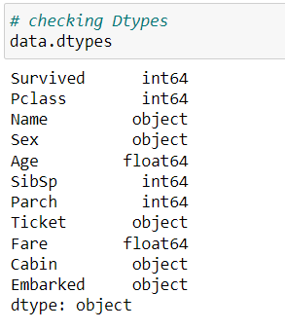
CHECKING DATA TYPES

Slide 9
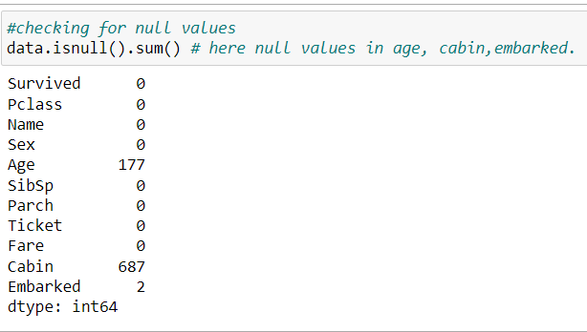
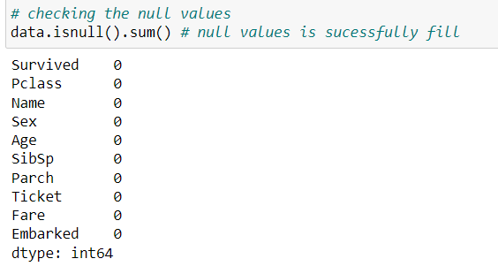
DEALING WITH NULL VALUES

Slide 10




Since the Age contains values in float we can fill null values with its mean.
Since the Age contains values in
float so we can fill null values
with its mean.
Null Values in the column‘Embarked’ has been replaced
with its mode (most repeated value).

Slide 11
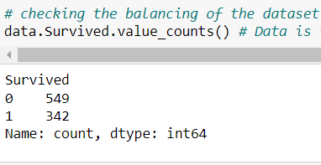
BALANCING OF THE DATASET
Not Survived - 549
Survived - 342

Slide 12
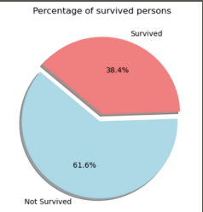
EDA - (EXPLORATORY DATA ANALYSIS)
This pie chart visualizes the percentage of surviving persons from the Titanic dataset. It shows that 38.4% of individuals survived the disaster, while the majority, comprising 61.6% did not survive. This stark contrast highlights the tragic outcome of the Titanic's sinking and underscores the importance of understanding factors that influenced survival rates.

Slide 13
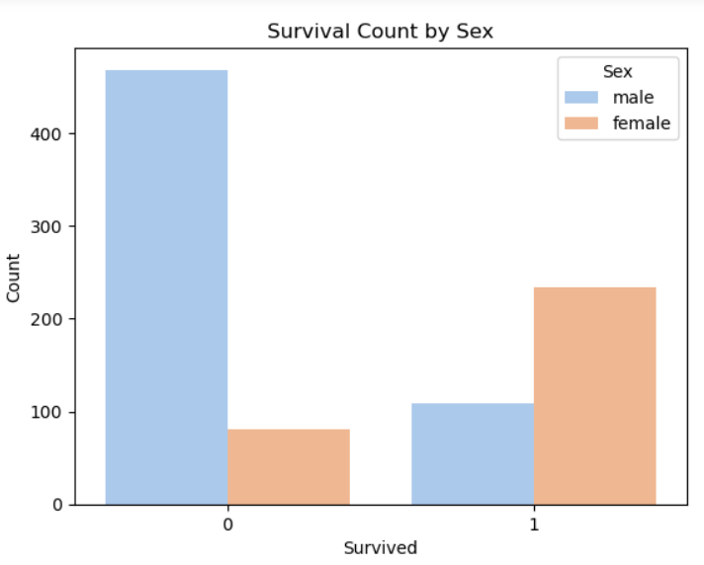
This bar plot visualizes the survival count by sex from the Titanic dataset. It reveals that a
A larger number of males did not survive the disaster, whereas a greater proportion of
females survived. This discrepancy suggests a potential correlation between sex and
survival on the Titanic, highlighting the importance of considering gender dynamics in
analyzing historical events like this

Slide 14
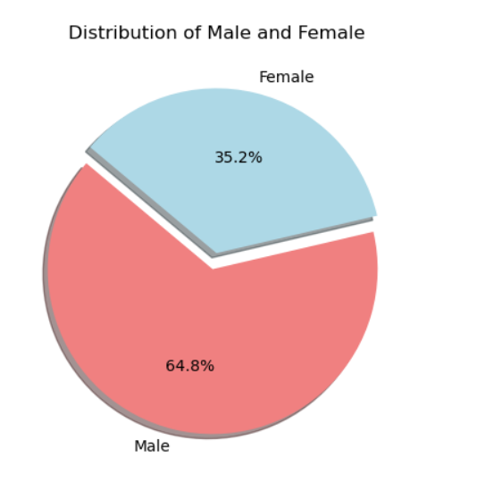
This pie chart illustrates the distribution of males and female in the Titanic dataset.
It indicates that approximately 64.8% of the
individuals in the dataset are male, while around 35.2% are female.
This gender distribution provides valuable insight into the composition of passengers aboard the Titanic and underscores the
importance of considering gender
dynamics in analyzing historical
events.

Slide 15
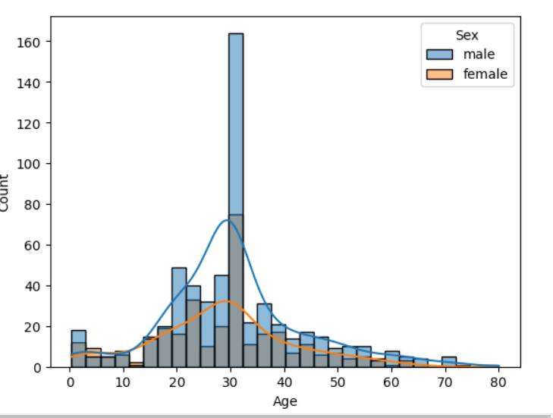
This histogram with density plot overlays depicts the distribution of ages among male and female passengers in the Titanic dataset.
The histogram bars represent the count of individuals within different age groups, while the density curves provide an estimation of the probability density function for each gender.

Slide 16
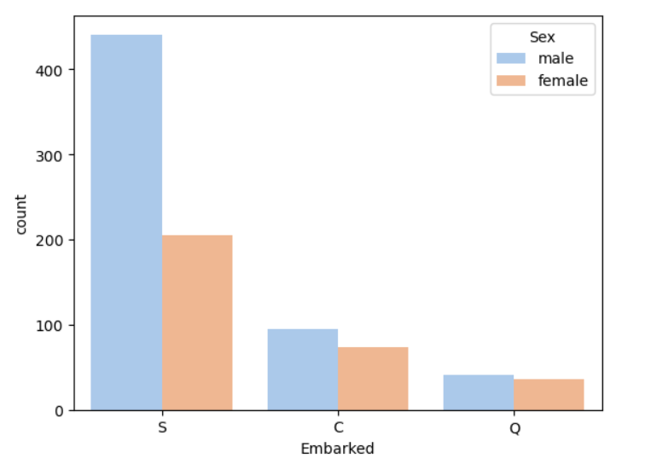
This bar plot illustrates the count of passengers based on their port of embarkation (S =Southampton, C=Cherbourg ,Q= Queenstown) and their respective genders.
It's evident that the majority of passengers embarked from Southampton, with a higher proportion of males compared to females.
Cherbourg had the second highest number of passengers, with a relatively unbalanced distribution between males and females. Q

Slide 17
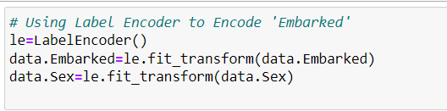
PREDICTION
STEP - 1
Here, we instantiate a Label Encoder object and then use the `fit transform` method to
encode the 'Embarked' and 'Sex' columns of the Data Frame `df`. This process assigns
numerical labels to each unique category in these columns, making them suitable for
Machine-learning algorithms that require numerical input.

Slide 18
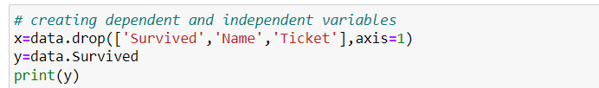
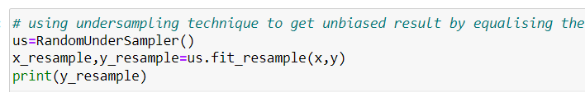
STEP-2
Here,x is assigned the data frame df after
Dropping the columns “Survived” and “Name” along the columns axis (axis=1)
Make it the independent variable matrix. Y is assigned the “Survived” columns
From the DataFrame df, representing the
Dependent variable where x contains the features used for prediction and y contains the target variable to be predicted.
Here, a RandomUnderSampler object ‘us’ is instantiated, which will randomly Undersample the majority class(0 for ‘Not Survived’)to balance the class distribution.
The ‘fit_resample’method is then applied to the independent variable matrix ‘x’ and the dependent variable to perform the undersampling.
The resulting ‘x_resample’and ‘y_resampling ‘contain the balanced dataset.
STEP-3

Slide 19
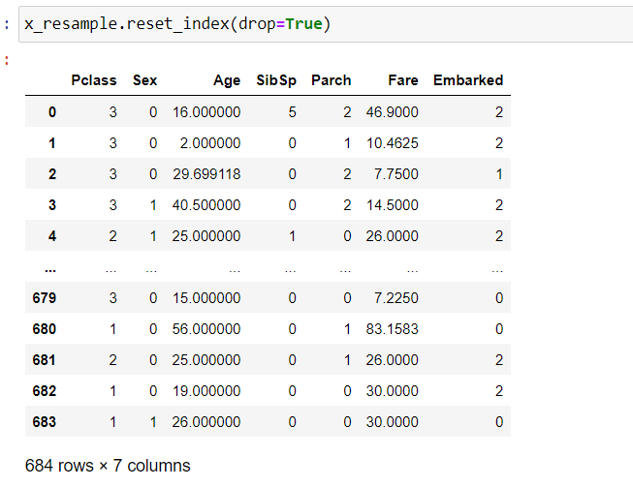
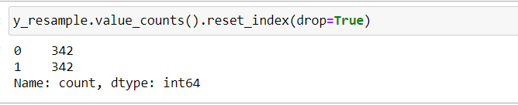
STEP-4
The code `x_resample’reset_index(drop=True)` resets the index of the Data Frame ‘x_resample` after under-sampling, dropping the old index.
This ensures that the index is reset to consecutive integers starting from 0, maintaining the integrity of the data after Under-sampling.
The resulting data frame shows 684 rows and 7 columns, indicating that the index has
been successfully reset, and the data frame is ready for further analysis or modeling tasks.

Slide 20
STEP - 5
Here, the `train_test_split` function from sci-kit-learn is used to split the independent variable matrix `x` and the dependent variable `y` into training and testing sets.
The parameter `test size=0.20` specifies that 20% of the data will be used for testing, while the remaining 80% will be used for training.
Additionally, `random state=46` sets the random seed for reproducibility, ensuring that the same random split is obtained each time
the code is run.

Slide 21

STEP - 6
Here, the RandomForestClassifier from scikit-learn is instantiated with parameter`n_estimators=100` and
`max_depth=5`.
This creates a random forest classifier with 100 decision trees (estimators) and a maximum depth of 5 for each tree. The `rfc` variable now holds this classifier object, which can be used for training and making predictions on the dataset.
STEP - 7
Here, the fit method of the RandomForestClassifier rfc is called with the training data x_train and y_train as arguments.
This step trains the random forest classifier on the training data, allowing it to learn the patterns and relationships between the features and the target variable.

Slide 22


STEP - 8
Here, the prediction method of the trained Random Forest Classifier rfc is used to predict the target variable based on the features in the testing dataset x_test. The predicted values are stored in the variable y_pred, which can be used for evaluating the performance and comparing it against the actual values in y_test.
STEP - 9
Here, the accuracy_score function from scikit-learn is used to compute the accuracy of the model by comparing the predicted values y_pred with the actual values y_test. This function returns the accuracy score, which represents the proportion of correctly classified instances out of the total number of instances in the testing dataset.

Slide 23
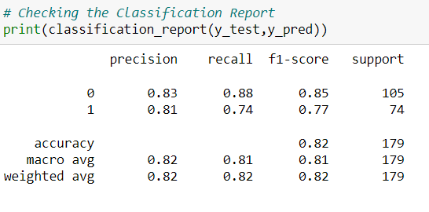
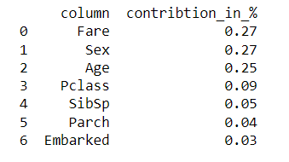
Classification Report
Feature Imp.

Slide 24
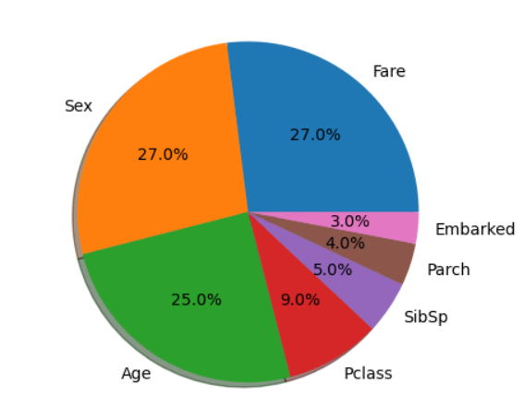
Feature Imp

Slide 25
CONCLUSION
In conclusion, this project aimed to predict the survival of passengers aboard the Titanic using machine learning
techniques.
The dataset was first explored and preprocessed to handle missing values and encode categorical variables.
Various visualizations were employed to understand the data distribution and relationships between different
features.
Next, a Random Forest Classifier model was trained on the preprocessed data. The model was evaluated using
metrics such as accuracy, precision, recall, and F1-score.
The classification report revealed that the model performed reasonably well, with an overall accuracy of 81%.
It achieved high precision and recall for predicting both survival and non-survival cases, indicating a good balance between correctly identifying survivors and non-survivors.
Overall, this project demonstrates the application of machine learning algorithms in predicting survival outcomes based on historical data, offering insights into factors influencing survival rates on the Titanic.
Further improvements and optimizations could be explored to enhance the model's performance.

Slide 26
THANK YOU

